Slide 1
TravelSafe
Infectious diseases
A bridge between you, community, and health.

Slide 2

A bridge between you, community, and Health.

Slide 3

Problems of Global travelling
unfamiliar
Travellers are not secured going to unfamiliar places without sufficient information about diseases.
Unspecific
Existing platforms are not specific about personal experiences in current diseases or during pandemic.

Slide 4
Travel health Risks
40 % of the travelers under age 40 believe “health/medical issues”
are the greatest threat while touring and exploring.
-Global Rescue Survey
40 %
“researchers from University of Toronto warned that the outbreak could quickly jump from Wuhan to other major cities because of international travel”
-abcnews.go.com
Notes:
The stats should show the problem exists.

Slide 5
01
02
We provide
Share Personal Experiences
Understanding more about the personal experiences
Information backup with sources
Familiarize the user about the current situation in their destination.

Slide 6
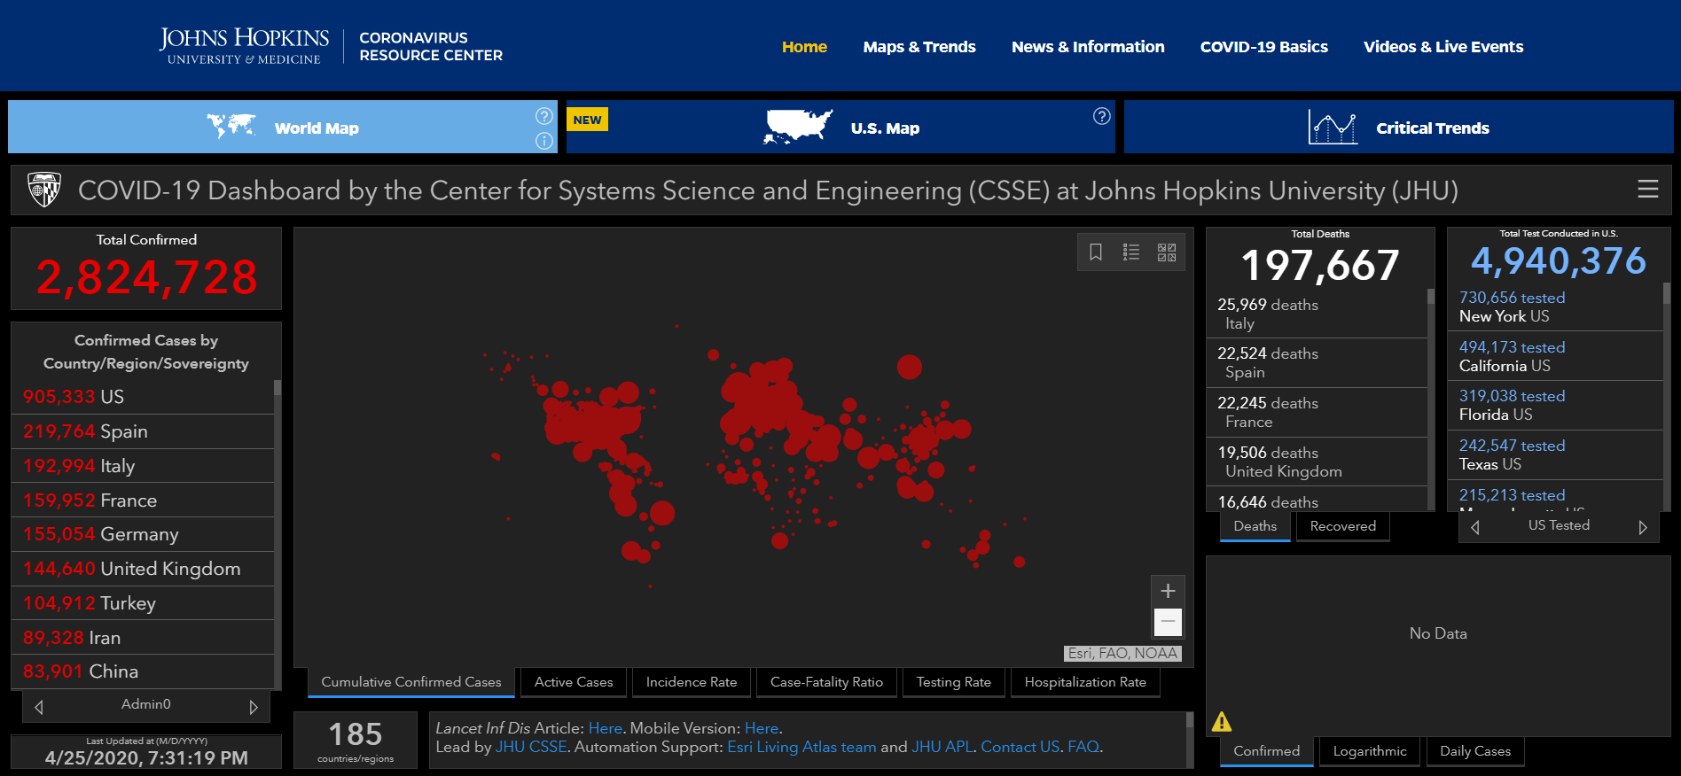
Our competitors
COVID Trackers
Specific only to covid-19
Not able to share Personal Experiences
From Johns Hopkins University
Notes:
Add features one or 2

Slide 7
Strengths
Categorized into sourced information and personal experiences per country.
Provide emotional support to travelers.
Locate essential places (pharmacies, supermarkets, hospitals) for traveling.
Present symptoms of infectious diseases.
Wide coverage of countries and infectious diseases.
Suggest emergency hotlines.
Book flights directly.
Weaknesses
We cannot filter fake news.
Limited information about infectious diseases in less developed countries.
Lack of reputation
.
Opportunities
Increased health awareness due to COVID-19.
No dominant competition.
Threats
Susceptible to bias which sources should we allow.
Possible drop in health awareness in the long term.

Slide 8
TIMELINE
May 2020
July 2020
Aug 2020
Sep 2020
OCT 2020
Dec 2020
jan 2021
Product development
Marketing & Testing
Pilot run (Social Media)
Partnerships (Travel agencies)
1st launch (Business travelers)
Analysis of the 1st launch
2nd launch (Travel & Leisure)

Slide 9
Pilot run
We invite key opinion leaders and social media influencers to review our product to gain exposure in the market.

Slide 10
Partnerships
We partner with business entities such as travel agencies and airlines to give incentives such as discounts or coupons to our users in exchange of promoting their business.

Slide 11
THANKS
Does anyone have any questions?
diego.pasquarelli@studenti.unipg.it
cylaubk@connect.ust.hk
damiano.fidati@studenti.unipg.it
elisa.acciari@studenti.unipg.it
tyloab@connect.ust.hk
alessandro.gionangeli@studenti.unipg.it
ivan.alex@ilazarte.com
Icons are from www.iconfinder.com

